Slide 1
Introduction to Machine Learning
CS5542 : Big Data Analytics and Apps
Reference: https://www.slideshare.net/larsga/introduction-to-big-datamachine-learning

Slide 2
Agenda
Introduction
Theory
Top 10 algorithms
Recommendations
Classification with naïve Bayes
Linear regression
Clustering
Principal Component Analysis
Conclusion

Slide 3
Introduction

Slide 4
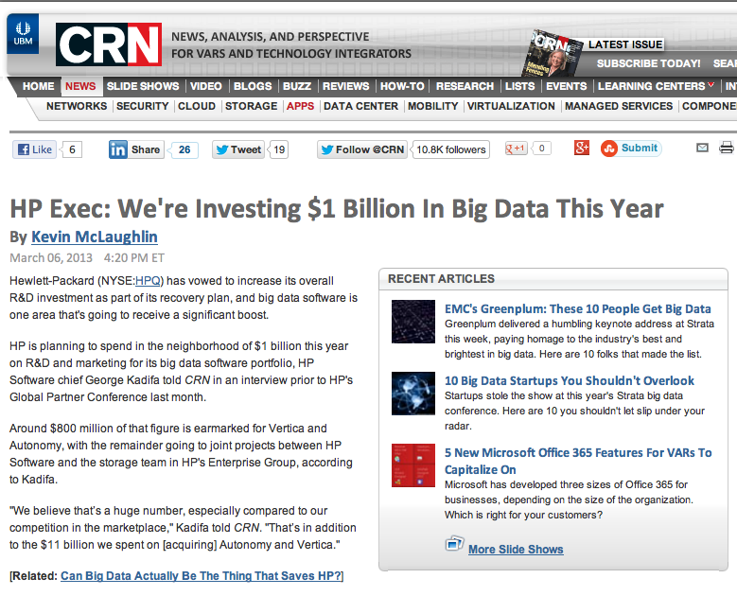

Slide 5
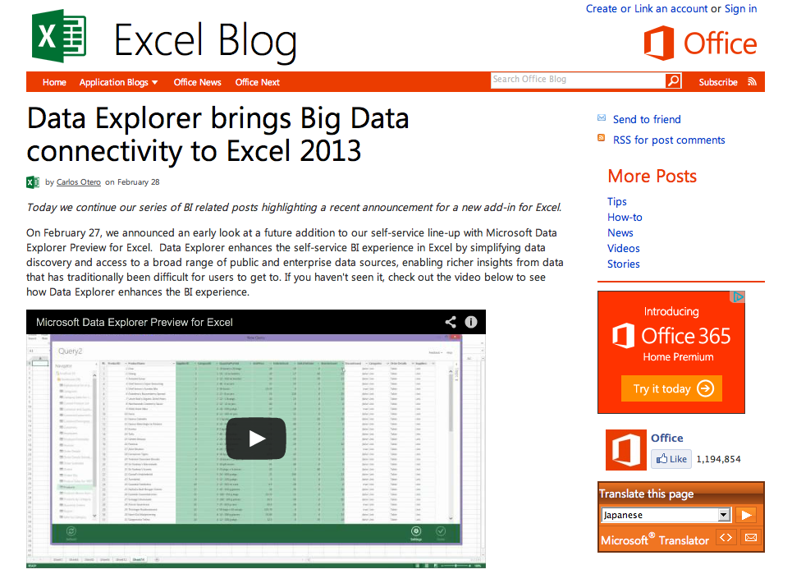

Slide 6

What is big data?
Big Data is any thing which is crash Excel.
Small Data is when is fit in RAM. Big Data is when is crash because is not fit in RAM.
Or, in other words, Big Data is data
in volumes too great to process by
traditional methods.
https://twitter.com/devops_borat

Slide 7
Data accumulation
Today, data is accumulating at tremendous rates
click streams from web visitors
supermarket transactions
sensor readings
video camera footage
GPS trails
social media interactions
...
It really is becoming a challenge to store and process it all in a meaningful way

Slide 8
From WWW to VVV
Volume
data volumes are becoming unmanageable
Variety
data complexity is growing
more types of data captured than previously
Velocity
some data is arriving so rapidly that it must either be processed instantly, or lost
this is a whole subfield called “stream processing”

Slide 9
The promise of Big Data
Data contains information of great business value
If you can extract those insights you can make far better decisions
...but is data really that valuable?

Slide 10


Slide 11
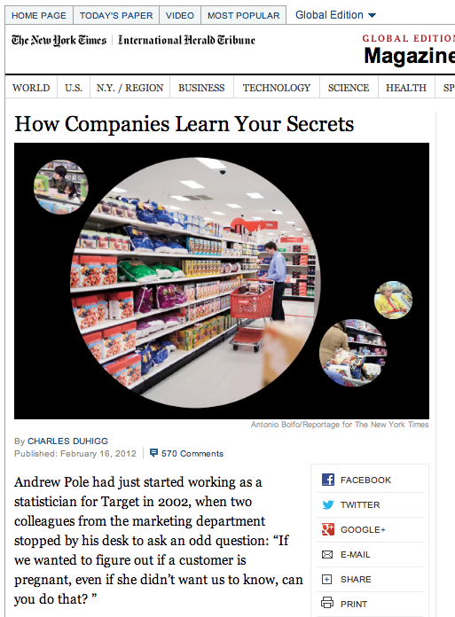
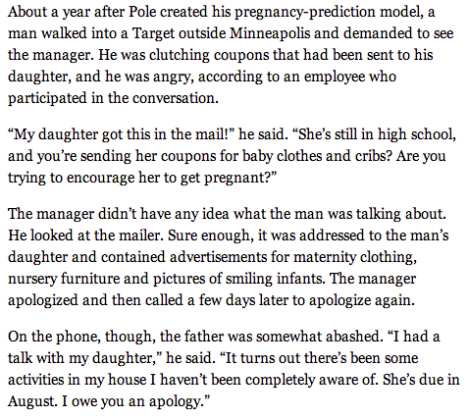

Slide 12
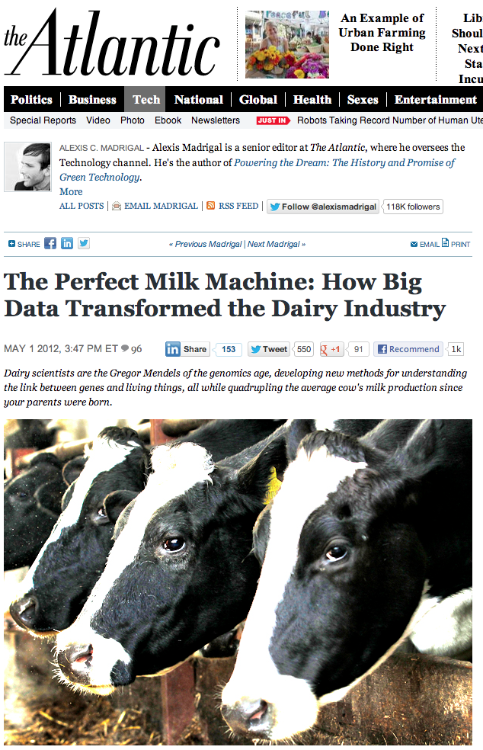
“quadrupling the average cow's milk production since your parents were born”
"When Freddie [as he is known] had no daughter records our equations predicted from his DNA that he would be the best bull," USDA research geneticist Paul VanRaden emailed me with a detectable hint of pride. "Now he is the best progeny tested bull (as predicted)."

Slide 13
Some more examples
Sports
basketball increasingly driven by data analytics
soccer beginning to follow
Entertainment
House of Cards designed based on data analysis
increasing use of similar tools in Hollywood
“Visa Says Big Data Identifies Billions of Dollars in Fraud”
new Big Data analytics platform on Hadoop
“Facebook is about to launch Big Data play”
starting to connect Facebook with real life
https://delicious.com/larsbot/big-data

Slide 14
Ok, ok, but ... does it apply to our customers?
Norwegian Food Safety Authority
accumulates data on all farm animals
birth, death, movements, medication, samples, ...
Hafslund
time series from hydroelectric dams, power prices, meters of individual customers, ...
Social Security Administration
data on individual cases, actions taken, outcomes...
Statoil
massive amounts of data from oil exploration, operations, logistics, engineering, ...
Retailers
see Target example above
also, connection between what people buy, weather forecast, logistics, ...

Slide 15
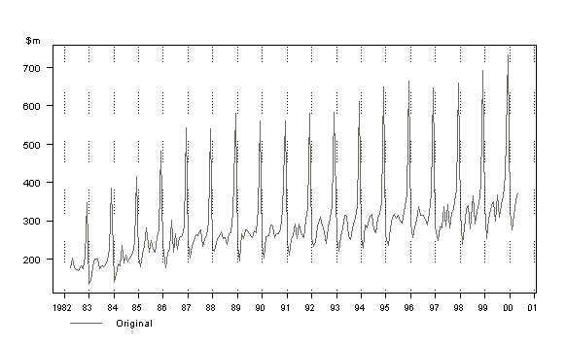
How to extract insight from data?
Monthly Retail Sales in New South Wales (NSW) Retail Department Stores

Slide 16
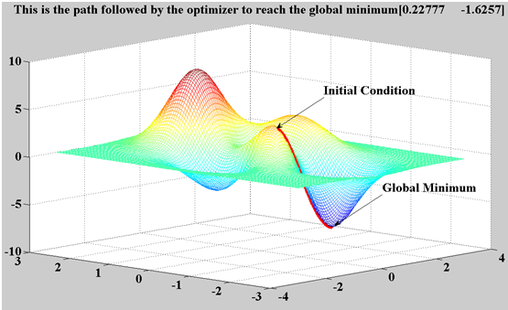
Types of algorithms
Clustering
Association learning
Parameter estimation
Recommendation engines
Classification
Similarity matching
Neural networks
Bayesian networks
Genetic algorithms

Slide 17
Basically, it’s all maths...
Linear algebra
Calculus
Probability theory
Graph theory
...
Only 10% in devops are know how of work with Big Data. Only 1% are realize they are need 2 Big Data for fault tolerance
17
https://twitter.com/devops_borat

Slide 18

Big data skills gap
Hardly anyone knows this stuff
It’s a big field, with lots and lots of theory
And it’s all maths, so it’s tricky to learn
http://www.ibmbigdatahub.com/blog/addressing-big-data-skills-gap
http://wikibon.org/wiki/v/Big_Data:_Hadoop,_Business_Analytics_and_Beyond#The_Big_Data_Skills_Gap

Slide 19

Two orthogonal aspects
Analytics / machine learning
learning insights from data
Big data
handling massive data volumes
Can be combined, or used separately

Slide 20

Data science?
http://drewconway.com/zia/2013/3/26/the-data-science-venn-diagram

Slide 21
How to process Big Data?
If relational databases are not enough, what is?
Mining of Big Data is problem solve in 2013 with zgrep
https://twitter.com/devops_borat

Slide 22
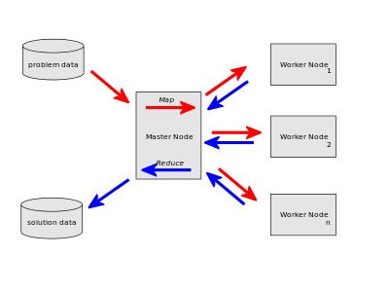

MapReduce
A framework for writing massively parallel code
Simple, straightforward model
Based on “map” and “reduce” functions from functional programming (LISP)

Slide 23
NoSQL and Big Data
Not really that relevant
Traditional databases handle big data sets, too
NoSQL databases have poor analytics
MapReduce often works from text files
can obviously work from SQL and NoSQL, too
NoSQL is more for high throughput
basically, AP from the CAP theorem, instead of CP
In practice, really Big Data is likely to be a mix
text files, NoSQL, and SQL

Slide 24
The 4th V: Veracity
“The greatest enemy of knowledge is not ignorance, it is the illusion of knowledge.”
Daniel Borstin, in The Discoverers (1983)
95% of time, when is clean Big Data is get Little Data
https://twitter.com/devops_borat

Slide 25
Data quality
A huge problem in practice
any manually entered data is suspect
most data sets are in practice deeply problematic
Even automatically gathered data can be a problem
systematic problems with sensors
errors causing data loss
incorrect metadata about the sensor
Never, never, never trust the data without checking it!
garbage in, garbage out, etc

Slide 26
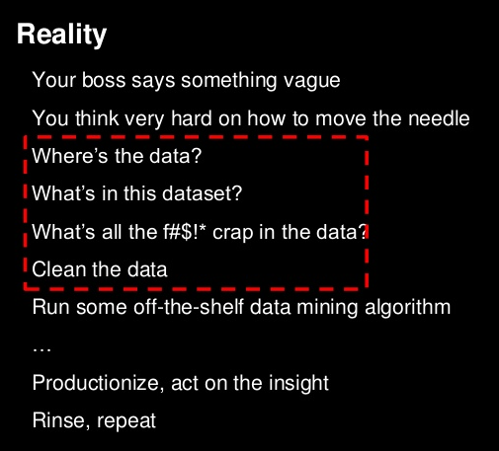
http://www.slideshare.net/Hadoop_Summit/scaling-big-data-mining-infrastructure-twitter-experience/12

Slide 27
Conclusion
Vast potential
to both big data and machine learning
Very difficult to realize that potential
requires mathematics, which nobody knows
We need to wake up!

Slide 28
Theory

Slide 29
Two kinds of learning
Supervised
we have training data with correct answers
use training data to prepare the algorithm
then apply it to data without a correct answer
Unsupervised
no training data
throw data into the algorithm, hope it makes some kind of sense out of the data

Slide 30
Some types of algorithms
Prediction
predicting a variable from data
Classification
assigning records to predefined groups
Clustering
splitting records into groups based on similarity
Association learning
seeing what often appears together with what

Slide 31
Issues
Data is usually noisy in some way
imprecise input values
hidden/latent input values
Inductive bias
basically, the shape of the algorithm we choose
may not fit the data at all
may induce underfitting or overfitting
Machine learning without inductive bias is not possible

Slide 32
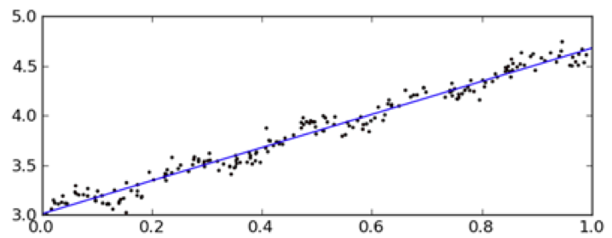
Underfitting
Using an algorithm that cannot capture the full complexity of the data

Slide 33
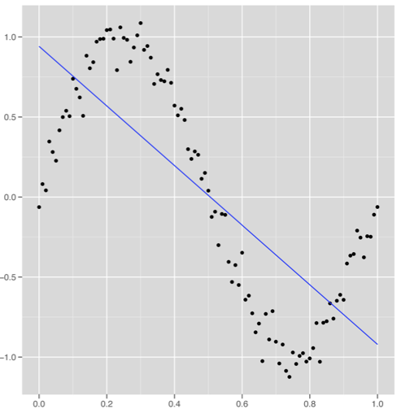
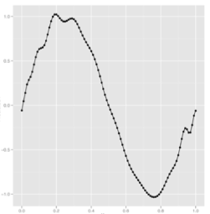
Overfitting
Tuning the algorithm so carefully it starts matching the noise in the training data

Slide 34
“What if the knowledge and data we have are not sufficient to completely determine the correct classifier? Then we run the risk of just hallucinating a classifier (or parts of it) that is not grounded in reality, and is simply encoding random quirks in the data. This problem is called overfitting, and is the bugbear of machine learning. When your learner outputs a classifier that is 100% accurate on the training data but only 50% accurate on test data, when in fact it could have output one that is 75% accurate on both, it has overfit.”
http://homes.cs.washington.edu/~pedrod/papers/cacm12.pdf

Slide 35
Testing
When doing this for real, testing is crucial
Testing means splitting your data set
training data (used as input to algorithm)
test data (used for evaluation only)
Need to compute some measure of performance
precision/recall
root mean square error
A huge field of theory here
will not go into it in this course
very important in practice

Slide 36
Missing values
Usually, there are missing values in the data set
that is, some records have some NULL values
These cause problems for many machine learning algorithms
Need to solve somehow
remove all records with NULLs
use a default value
estimate a replacement value
...

Slide 37
Terminology
Vector
one-dimensional array
Matrix
two-dimensional array
Linear algebra
algebra with vectors and matrices
addition, multiplication, transposition, ...

Slide 38
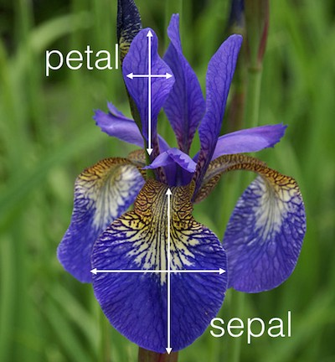
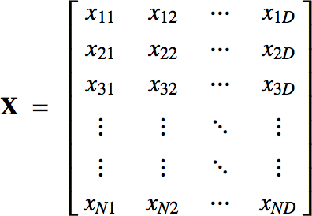
Nomenclature
IRIS
https://archive.ics.uci.edu/ml/datasets/Iris
Instances (samples, observations)
 | sepal_length | sepal_width | petal_length | petal_width | class
1 | 5.1 | 3.5 | 1.4 | 0.2 | setosa
2 | 4.9 | 3.0 | 1.4 | 0.2 | setosa
… | … | … | … | … | …
50 | 6.4 | 3.2 | 4.5 | 1.5 | veriscolor
… | … | … | … | … | …
150 | 5.9 | 3.0 | 5.1 | 1.8 | virginica
Features (attributes, dimensions)
Classes (targets)

Slide 39
Top 10 algorithms

Slide 40
Top 10 machine learning algs
C4.5
k-means clustering
Support vector machines
the Apriori algorithm
the EM algorithm
PageRank
AdaBoost
k-nearest neighbours class.
Naïve Bayes
CART
From a survey at IEEE International Conference on Data Mining (ICDM) in December 2006. “Top 10 algorithms in data mining”, by X. Wu et al

Slide 41
C4.5
Algorithm for building decision trees
basically trees of boolean expressions
each node split the data set in two
leaves assign items to classes
Decision trees are useful not just for classification
they can also teach you something about the classes
C4.5 is a bit involved to learn
the ID3 algorithm is much simpler
CART (#10) is another algorithm for learning decision trees

Slide 42
Support Vector Machines
A way to do binary classification on matrices
Support vectors are the data points nearest to the hyperplane that divides the classes
SVMs maximize the distance between SVs and the boundary
Particularly valuable because of “the kernel trick”
using a transformation to a higher dimension to handle more complex class boundaries
A bit of work to learn, but manageable

Slide 43
Apriori
An algorithm for “frequent itemsets”
basically, working out which items frequently appear together
for example, what goods are often bought together in the supermarket?
used for Amazon’s “customers who bought this...”
Can also be used to find association rules
that is, “people who buy X often buy Y” or similar
Apriori is slow
a faster, further development is FP-growth
http://www.dssresources.com/newsletters/66.php

Slide 44
Expectation Maximization
A deeply interesting algorithm I’ve seen used in a number of contexts
very hard to understand what it does
very heavy on the maths
Essentially an iterative algorithm
skips between “expectation” step and “maximization” step
tries to optimize the output of a function
Can be used for
clustering
a number of more specialized examples, too

Slide 45
PageRank
Basically a graph analysis algorithm
identifies the most prominent nodes
used for weighting search results on Google
Can be applied to any graph
for example an RDF data set
Basically works by simulating random walk
estimating the likelihood that a walker would be on a given node at a given time
actual implementation is linear algebra
The basic algorithm has some issues
“spider traps”
graph must be connected
straightforward solutions to these exist

Slide 46
AdaBoost
Algorithm for “ensemble learning”
That is, for combining several algorithms
and training them on the same data
Combining more algorithms can be very effective
usually better than a single algorithm
AdaBoost basically weights training samples
giving the most weight to those which are classified the worst

Slide 47
Recommendations

Slide 48
Collaborative filtering
Basically, you’ve got some set of items
these can be movies, books, beers, whatever
You’ve also got ratings from users
on a scale of 1-5, 1-10, whatever
Can you use this to recommend items to a user, based on their ratings?
if you use the connection between their ratings and other people’s ratings, it’s called collaborative filtering
other approaches are possible

Slide 49
Feature-based recommendation
Use user’s ratings of items
run an algorithm to learn what features of items the user likes
Can be difficult to apply because
requires detailed information about items
key features may not be present in data
Recommending music may be difficult, for example

Slide 50
A simple idea
If we can find ratings from people similar to you, we can see what they liked
the assumption is that you should also like it, since your other ratings agreed so well
You can take the average ratings of the k people most similar to you
then display the items with the highest averages
This approach is called k-nearest neighbours
it’s simple, computationally inexpensive, and works pretty well
there are, however, some tricks involved

Slide 51
Similarity functions
Minkowski distance
basically geometric distance, generalized to any number of dimensions
Pearson correlation coefficient
Vector cosine
measures angle between vectors
Root mean square error (RMSE)
square root of the mean of square differences between data values

Slide 52
Root Mean Square Error
This is a measure that’s often used to judge the quality of prediction
predicted value: x
actual value: y
For each pair of values, do
(y - x)²
Procedure
sum over all pairs,
divide by the number of values (to get average),
take the square root of that (to undo squaring)
We use the square because
that always gives us a positive number,
it emphasizes bigger deviations

Slide 53
Naïve Bayes

Slide 54
Bayes’s Theorem
Basically a theorem for combining probabilities
I’ve observed A, which indicates H is true with probability 70%
I’ve also observed B, which indicates H is true with probability 85%
what should I conclude?
Naïve Bayes is basically using this theorem
with the assumption that A and B are indepedent
this assumption is nearly always false, hence “naïve”

Slide 55
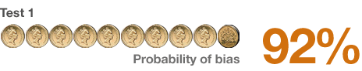
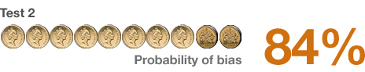
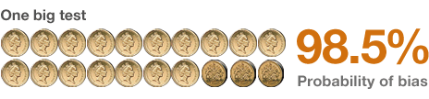
Simple example
Is the coin fair or not?
we throw it 10 times, get 9 heads and one tail
we try again, get 8 heads and two tails
What do we know now?
can combine data and recompute
or just use Bayes’s Theorem directly
>>> compute_bayes([0.92, 0.84])
0.9837067209775967
http://www.bbc.co.uk/news/magazine-22310186

Slide 56
Linear regression

Slide 57
Linear regression
Let’s say we have a number of numerical parameters for an object
We want to use these to predict some other value
Examples
estimating real estate prices
predicting the rating of a beer
...

Slide 58
Estimating real estate prices
Take parameters
x₁ square meters
x₂ number of rooms
x₃ number of floors
x₄ energy cost per year
x₅ meters to nearest subway station
x₆ years since built
x₇ years since last refurbished
...
a x₁ + b x₂ + c x₃ + ... = price
strip out the x-es and you have a vector
collect N samples of real flats with prices = matrix
welcome to the world of linear algebra

Slide 59

Our data set: beer ratings
Ratebeer.com
a web site for rating beer
scale of 0.5 to 5.0
For each beer we know
alcohol %
country of origin
brewery
beer style (IPA, pilsener, stout, ...)
But ... only one attribute is numeric!
how to solve?

Slide 60
Example
ABV | .se | .nl | .us | .uk | IIPA | Black IPA | Pale ale | Bitter | Rating
8.5 | 1.0 | 0.0 | 0.0 | 0.0 | 1.0 | 0.0 | 0.0 | 0.0 | 3.5
8.0 | 0.0 | 1.0 | 0.0 | 0.0 | 0.0 | 1.0 | 0.0 | 0.0 | 3.7
6.2 | 0.0 | 0.0 | 1.0 | 0.0 | 0.0 | 0.0 | 1.0 | 0.0 | 3.2
4.4 | 0.0 | 0.0 | 0.0 | 1.0 | 0.0 | 0.0 | 0.0 | 1.0 | 3.2
... | ... | ... | ... | ... | ... | ... | ... | ... | ...
Basically, we turn each category into a column of 0.0 or 1.0 values.

Slide 61
Normalization
If some columns have much bigger values than the others they will automatically dominate predictions
We solve this by normalization
Basically, all values get resized into the 0.0-1.0 range
For ABV we set a ceiling of 15%
compute with min(15.0, abv) / 15.0

Slide 62
Adding more data
To get a bit more data, I added manually a description of each beer style
Each beer style got a 0.0-1.0 rating on
colour (pale/dark)
sweetness
hoppiness
sourness
These ratings are kind of coarse because all beers of the same style get the same value

Slide 63
Making predictions
We’re looking for a formula
a * abv + b * .se + c * .nl + d * .us + ... = rating
We have n examples
a * 8.5 + b * 1.0 + c * 0.0 + d * 0.0 + ... = 3.5
We have one unknown per column
as long as we have more rows than columns we can solve the equation
Interestingly, matrix operations can be used to solve this easily

Slide 64
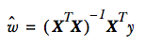
Matrix formulation
Let’s say
x is our data matrix
y is a vector with the ratings and
w is a vector with the a, b, c, ... values
That is: x * w = y
this is the same as the original equation
a x₁ + b x₂ + c x₃ + ... = rating
If we solve this, we get

Slide 65
Clustering

Slide 66
Clustering
Basically, take a set of objects and sort them into groups
objects that are similar go into the same group
The groups are not defined beforehand
Sometimes the number of groups to create is input to the algorithm
Many, many different algorithms for this

Slide 67
Sample data
Our sample data set is data about aircraft from DBpedia
For each aircraft model we have
name
length (m)
height (m)
wingspan (m)
number of crew members
operational ceiling, or max height (m)
max speed (km/h)
empty weight (kg)
We use a subset of the data
149 aircraft models which all have values for all of these properties
Also, all values normalized to the 0.0-1.0 range

Slide 68
Distance
All clustering algorithms require a distance function
that is, a measure of similarity between two objects
Any kind of distance function can be used
generally, lower values mean more similar
Examples of distance functions
metric distance
vector cosine
RMSE
...

Slide 69
k-means clustering
Input: the number of clusters to create (k)
Pick k objects
these are your initial clusters
For all objects, find nearest cluster
assign the object to that cluster
For each cluster, compute mean of all properties
use these mean values to compute distance to clusters
the mean is often referred to as a “centroid”
go back to previous step
Continue until no objects change cluster

Slide 70
First attempt at aircraft
We leave out name and number built when doing comparison
We use RMSE as the distance measure
We set k = 5
What happens?
first iteration: all 149 assigned to a cluster
second: 11 models change cluster
third: 7 change
fourth: 5 change
fifth: 5 change
sixth: 2
seventh: 1
eighth: 0

Slide 71
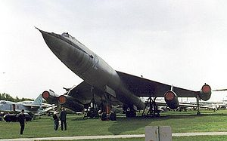
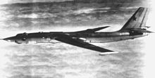

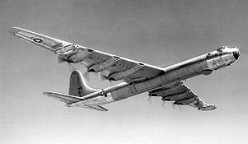
Cluster 5
cluster5, 4 models
ceiling : 13400.0
maxspeed : 1149.7
crew : 7.5
length : 47.275
height : 11.65
emptyweight : 69357.5
wingspan : 47.18
3 jet bombers, one
propeller bomber.
Not too bad.
The Myasishchev M-50 was a Soviet prototype four-engine supersonic bomber which never attained service
The Myasishchev M-4 Molot is a four-engined strategic bomber
The Convair B-36 "Peacemaker” was a strategic bomber built by Convair and operated solely by the United States Air Force (USAF) from 1949 to 1959
The Tupolev Tu-16 was a twin-engine jet bomber used by the Soviet Union.

Slide 72
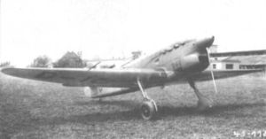
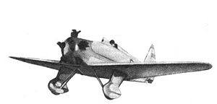
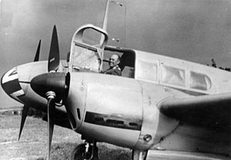
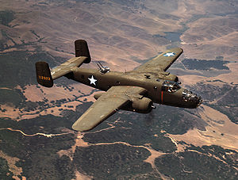

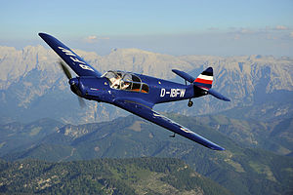
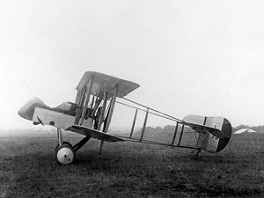
Cluster 4
cluster4, 56 models
ceiling : 5898.2
maxspeed : 259.8
crew : 2.2
length : 10.0
height : 3.3
emptyweight : 2202.5
wingspan : 13.8
Small, slow propeller aircraft.
Not too bad.
The Avia B.135 was a Czechoslovak cantilever monoplane fighter aircraft
The Yakovlev UT-1 was a single-seater trainer aircraft
The Siebel Fh 104 Hallore was a small German twin-engined transport, communications and liaison aircraft
The Yakovlev UT-2 was a single-seater trainer aircraft
The North American B-25 Mitchell was an American twin-engined medium bomber
The Airco DH.2 was a single-seat biplane "pusher" aircraft
The Messerschmitt Bf 108 Taifun was a German single-engine sports and touring aircraft

Slide 73

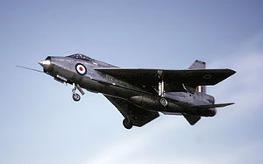
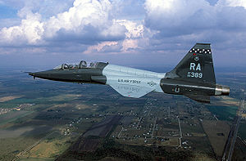
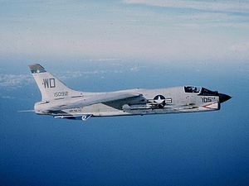


Cluster 3
Small, very fast jet planes. Pretty good.
cluster3, 12 models
ceiling : 16921.1
maxspeed : 2456.9
crew : 2.67
length : 17.2
height : 4.92
emptyweight : 9941
wingspan : 10.1
The Mikoyan MiG-29 is a fourth-generation jet fighter aircraft
The English Electric Lightning is a supersonic jet fighter aircraft of the Cold War era, noted for its great speed.
The Northrop T-38 Talon is a two-seat, twin-engine supersonic jet trainer
The Vought F-8 Crusader was a single-engine, supersonic [fighter] aircraft
The Dassault Mirage 5 is a supersonic attack aircraft
The Mikoyan MiG-35 is a further development of the MiG-29

Slide 74
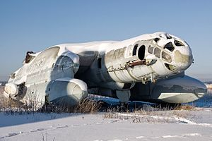
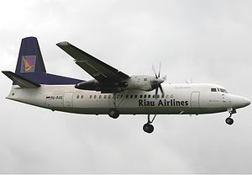
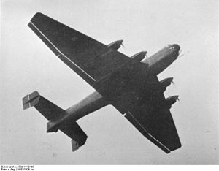
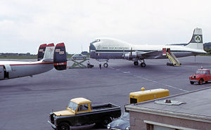
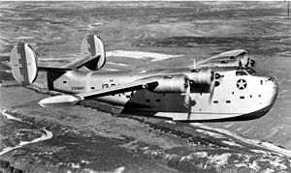
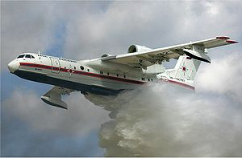
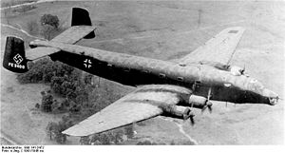
Cluster 2
Biggish, kind of slow planes.
Some oddballs in this group.
cluster2, 27 models
ceiling : 6447.5
maxspeed : 435
crew : 5.4
length : 24.4
height : 6.7
emptyweight : 16894
wingspan : 32.8
The Bartini Beriev VVA-14 (vertical take-off amphibious aircraft)
The Fokker 50 is a turboprop-powered airliner
The Junkers Ju 89 was a heavy bomber
The Aviation Traders ATL-98 Carvair was a large piston-engine transport aircraft.
The PB2Y Coronado was a large flying boat patrol bomber
The Beriev Be-200 Altair is a multipurpose amphibious aircraft
The Junkers Ju 290 was a long-range transport, maritime patrol aircraft and heavy bomber

Slide 75
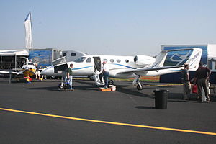
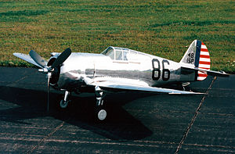

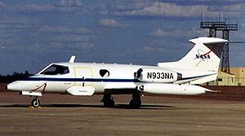
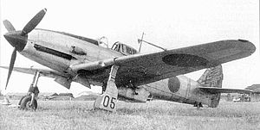
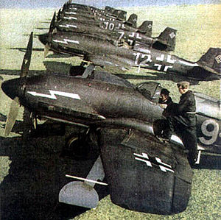
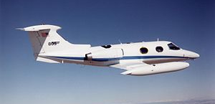
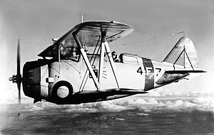
Cluster 1
cluster1, 50 models
ceiling : 11612
maxspeed : 726.4
crew : 1.6
length : 11.9
height : 3.8
emptyweight : 5303
wingspan : 13
Small, fast planes. Mostly good, though the Canberra is a poor fit.
The Adam A700 AdamJet was a proposed six-seat civil utility aircraft
The Curtiss P-36 Hawk was an American-designed and built fighter aircraft
The English Electric Canberra is a first-generation jet-powered light bomber
The Heinkel He 100 was a German pre-World War II fighter aircraft
The Learjet 23 is a ... twin-engine, high-speed business jet
The Kawasaki Ki-61 Hien was a Japanese World War II fighter aircraft
The Learjet 24 is a ... twin-engine, high-speed business jet
The Grumman F3F was the last American biplane fighter aircraft

Slide 76
Clusters, summarizing
Cluster 1: small, fast aircraft (750 km/h)
Cluster 2: big, slow aircraft (450 km/h)
Cluster 3: small, very fast jets (2500 km/h)
Cluster 4: small, very slow planes (250 km/h)
Cluster 5: big, fast jet planes (1150 km/h)
For a first attempt to sort through the data,
this is not bad at all
https://github.com/larsga/py-snippets/tree/master/machine-learning/aircraft

Slide 77
Agglomerative clustering
Put all objects in a pile
Make a cluster of the two objects closest to one another
from here on, treat clusters like objects
Repeat second step until satisfied
There is code for this, too, in the Github sample

Slide 78
Principal component analysis

Slide 79
PCA
Basically, using eigenvalue analysis to find out which variables contain the most information
the maths are pretty involved
and I’ve forgotten how it works
and I’ve thrown out my linear algebra book
and ordering a new one from Amazon takes too long
...so we’re going to do this intuitively

Slide 80
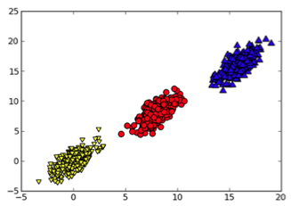
An example data set
Two variables
Three classes
What’s the longest line we could draw through the data?
That line is a vector in two dimensions
What dimension dominates?
that’s right: the horizontal
this implies the horizontal contains most of the information in the data set
PCA identifies the most significant variables

Slide 81
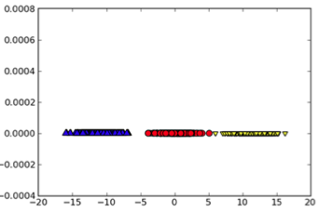
Dimensionality reduction
After PCA we know which dimensions matter
based on that information we can decide to throw out less important dimensions
Result
smaller data set
faster computations
easier to understand

Slide 82
Conclusion

Slide 83
Big data & machine learning
This is a huge field, growing very fast
Many algorithms and techniques
can be seen as a giant toolbox with wide-ranging applications
Ranging from the very simple to the extremely sophisticated
Difficult to see the big picture
Huge range of applications
Math skills are crucial

Slide 84

https://www.coursera.org/course/ml

Slide 85

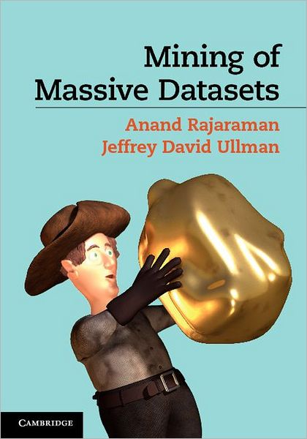
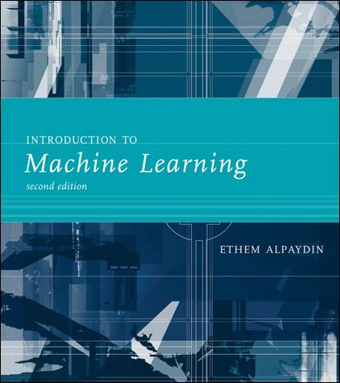
Books I recommend
http://infolab.stanford.edu/~ullman/mmds.html

